Slide 1

Lists
The Workhorse of Functional Programming

Slide 2
Overview
A list is a homogeneous aggregation mechanism.
The elements of a list must all have the same type.
Lists can dynamically change size.
Lists are first class citizens.
The list structure is defined recursively.
E.g., a list can contain elements that are (also) lists.

Slide 3
Lists are terms
The internal representation of lists

Slide 4
A term Language that includes lists
Consider a function called cons having the following signature.
Let nil be a nullary function (i.e., a constant) denoting the empty list.
Let us additionally require that terms involving the cons function we well typed.
cons: element ∗ element list → element list

Slide 5
Examples
Term | Type
nil | A term of type ′a list
cons( 1, nil) | A term of type int list
cons(true, nil) | A term of type bool list
cons(nil, 1) | Error – this term is not well typed
cons(1, cons(2, nil)) | A list containing two integer elements
cons((1,2),cons((3,4),nil) | A list containing two tuples

Slide 6
Matching with List patterns
If we syntactically represent lists as elements belonging to traditionally defined term languages, then matching with list patterns is straightforward.
Match Expression | Result
cons(x,nil) << cons(1,nil) | σ = [x:=1]
cons(x,xs) << cons(1,nil) | σ = [x:=1][xs:=nil]
cons(x,xs) << cons(1,cons(2,nil)) | σ = [x:=1][xs:=cons(2,nil)]
cons(x1,cons(x2,xs)) << cons(1,cons(2,nil)) | σ = [x1:=1][x2:=2][xs:=nil]
cons((loc,t),xs) << cons((1,“int”),nil) | σ = [loc:=1][t:=“int”][xs:=nil]

Slide 7
Variable naming conventions
When the specific nature of the elements of a list is unimportant (e.g., polymorphic functions on lists), then variables at the end of the alphabet are used to denote list elements (e.g., x, y, z).
When the variable x is used to denote a list element, then a list of x elements is denoted by the variable xs – the plural of x.

Slide 8

syntactic sugar
How lists are syntactically represented in SML

Slide 9
Syntax
A list is a comma-separated sequence of zero or more expressions enclosed in square brackets.
list ::= “[“ exprList “]”
exprList ::= expr “,” exprList | ∈

Slide 10
List Values
A list value is a list whose elements are values.
List Value | Type
[1,2,3] | int list
[(1,true),(2,false),(3,true)] | (int * bool) list
[ [1,2], [3], [4,5,6] ] | int list list
[] | ′a list
The reserved word nil also denotes the empty list.

Slide 11
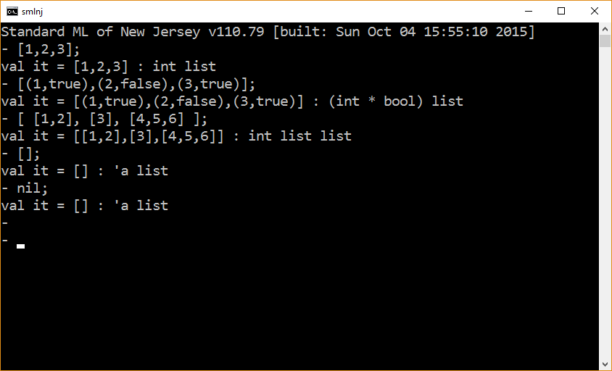

Slide 12
Evaluation
List evaluation is similar to tuple evaluation.
Lists are evaluated by evaluating their elements in a left-to-right fashion.
[ e₁, e₂, … , e_{n}]
→* [ v₁, e₂, … , e_{n}]
→* [ v₁, v₂, … , e_{n}]
→* [ v₁, v₂, … , v_{n}]

Slide 13
List operators :: and @
In SML,
the cons operator is a binary right-associative infix operator (technically speaking a constructor) that is denoted ::
the concatenation operator is a binary right-associative infix operator that is denoted @
operator | signature
:: | `a ∗ `a list → `a list
@ | `a list ∗ `a list → `a list

Slide 14
Expressions involving list operators
Expression | Result
1 :: [] | [1]
1::2::[] | [1,2]
1::2::[3,4] | [1,2,3,4]
[1,2] @ [3,4] | [1,2,3,4]
[] @ [1,2] | [1,2]
[1,2] @ [] | [1,2]

Slide 15
Special Cases
[] :: []
→
[[]]
[] @ []
→
[]

Slide 16
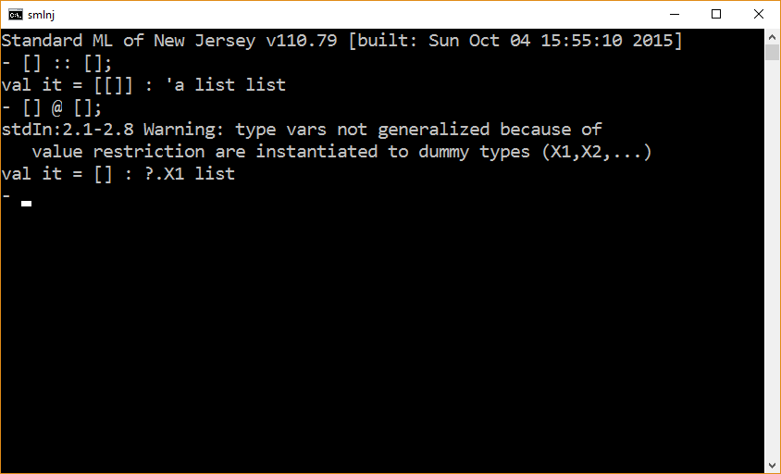

Slide 17
List patterns
A list pattern is a list whose elements are match patterns.
Technically speaking, a list pattern is a kind of match pattern.
Match patterns are static. They cannot be changed dynamically (i.e., during runtime).

Slide 18
List pattern matching | Result of Matching
val ys = [1,2,3]; | σ = [ ys := [1,2,3] ]
val [y1,y2,y3] = ys; | σ = [ y1 := 1 ][ y2 := 2 ][ y3 := 3 ]
val z1::z2::z3::zs = [1,2,3,4,5]; | σ = [ z1 := 1 ][ z2 := 2 ][ z3 := 3 ][ zs := [4,5] ]
val y1::y2::y3::ys = [1,2,3]; | σ = [ y1 := 1 ][ y2 := 2 ][ y3 := 3 ][ ys := [] ]

Slide 19
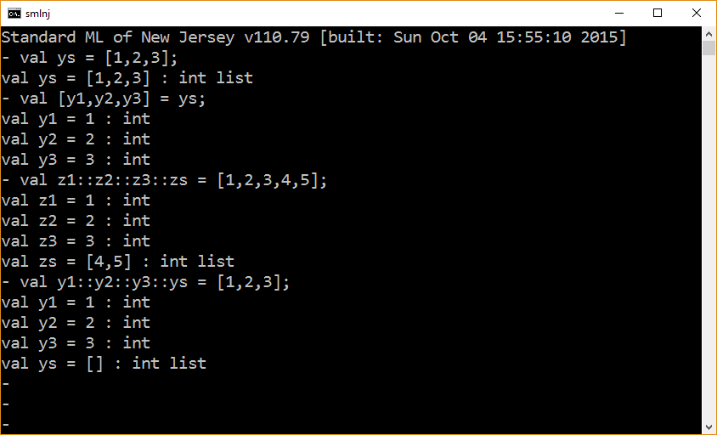

Slide 20
A word on Constructors
Syntactically – a constructor looks like a function call.
Semantically – a constructor behaves like an uninterpreted function call.
Terms that are values can contain constructors.
Because they are uninterpreted, term values that contain constructors can be deconstructed.
Matching can be used to deconstruct term values.

Slide 21
The difference between Cons and concatenation
The cons operator is a constructor.
Aggregate values that result from the application of cons operators can be deconstructed through matching.
The concatenation operator is a computation.
Aggregate values that result from the application of concatenation operators cannot be deconstructed through matching.

Slide 22
The end

